Slide 1
// HelloPoint1.js (c) 2012 Matsuda
// Vertex shader program
var VSHADER_SOURCE =
'void main() {\n' +
' gl_Position = vec4(0.0, 0.0, 0.0, 1.0);\n' + // Set the vertex coordinates
' gl_PointSize = 10.0;\n' + // Set the point size
'}\n';
// Fragment shader program
var FSHADER_SOURCE =
'void main() {\n' +
' gl_FragColor = vec4(1.0, 0.0, 0.0, 1.0);\n' + // Set the point color
'}\n';
function main() {
.
.
.
// Draw a point
gl.drawArrays(gl.POINTS, 0, 1); // Draw 1 point starting at beginning of “Array”
}

Slide 2
// HelloPoint2.js (c) 2012 Matsuda; The JavaScript program decides the position
// Vertex shader program
var VSHADER_SOURCE =
// attribute variables are per vertex data and are used only in vertex shaders
'attribute vec4 a_Position;\n' + // attribute variable for position
// global variable outside main()
'void main() {\n' +
' gl_Position = a_Position;\n' +
' gl_PointSize = 10.0;\n' +
'}\n';
// Fragment shader program
var FSHADER_SOURCE =
'void main() {\n' +
' gl_FragColor = vec4(1.0, 0.0, 0.0, 1.0);\n' +
'}\n';

Slide 3
<html lang="en">
<head>
<meta charset="utf-8" />
<title>Draw a point (1)</title>
</head>
<body onload="main()">
<canvas id="webgl" width="400" height="400">
Please use a browser that supports "canvas"
</canvas>
<script src="../lib/webgl-utils.js"></script>
<script src="../lib/webgl-debug.js"></script>
<script src="../lib/cuon-utils.js"></script>
<script src="HelloPoint2.js"></script>
</body>
</html>

Slide 4
// HelloPoint2.js (c) 2012 Matsuda; Pass an attribute variable for the position
function main() {
// Retrieve <canvas> element
var canvas = document.getElementById('webgl');
// Get the rendering context for WebGL
var gl = getWebGLContext(canvas); // convenience function in lib/cuon-utils.js
// Initialize shaders
initShaders(gl, VSHADER_SOURCE, FSHADER_SOURCE); // also in lib/cuon-utils.js
// Get the storage location of a_Position; book’s convention is to use the same name
var a_Position = gl.getAttribLocation(gl.program, 'a_Position');
// Pass vertex position to attribute variable
gl.vertexAttrib3f(a_Position, 0.0, 0.0, 0.0); // writes position into attribute
.
.
. // Draw
gl.drawArrays(gl.POINTS, 0, 1); // Draw 1 point starting at beginning of “Array”
}

Slide 5
// ColoredPoint.js (c) 2012 Matsuda; Change the point color from JavaScript
// Vertex shader program
var VSHADER_SOURCE =
// attribute variables are per vertex data and are used only in vertex shaders
'attribute vec4 a_Position;\n’ + // global variable, declared outside main()
'void main() {\n' +
' gl_Position = a_Position;\n' +
' gl_PointSize = 10.0;\n' +
'}\n';
// Fragment shader program
var FSHADER_SOURCE =
'precision mediump float;\n’ + // Fragment shaders must declare float prec.
// uniform variables are the same for all fragments in a gl.drawArrays() call
'uniform vec4 u_FragColor;\n' + // uniform, passed from JavaScript program
// global variable outside main()
'void main() {\n' +
' gl_FragColor = u_FragColor;\n' +
'}\n’;

Slide 6
function main() { // Pass a uniform variable for the color.
// Retrieve <canvas> element
var canvas = document.getElementById('webgl');
// Get the rendering context for WebGL
var gl = getWebGLContext(canvas);
// // Get the storage location of a_Position
var a_Position = gl.getAttribLocation(gl.program, 'a_Position');
// Get the storage location of u_FragColor
var u_FragColor = gl.getUniformLocation(gl.program, 'u_FragColor');
// Pass the color of a point to u_FragColor variable
gl.uniform4f(u_FragColor, 0., .2, .7, 1.);
// Draw
gl.drawArrays(gl.POINTS, 0, 1);
}

Slide 7
function main() { // ClickedPoints.js
// event handler to be called on a mouse press, a JavaScript anonymous function
canvas.onmousedown = function(ev){ click(ev, gl, canvas, a_Position); };
} var g_points = []; // The array for the position of a mouse press
function click(ev, gl, canvas, a_Position) {
var x = ev.clientX; // x coordinate of a mouse pointer
var y = ev.clientY; // y coordinate of a mouse pointer
var rect = ev.target.getBoundingClientRect() ;
x = ((x - rect.left) - canvas.width/2)/(canvas.width/2);
y = (canvas.height/2 - (y - rect.top))/(canvas.height/2);
// Store the coordinates to g_points array
g_points.push(x); g_points.push(y);
var len = g_points.length;
for(var i = 0; i < len; i += 2) {
// Pass the position of a point to a_Position variable
gl.vertexAttrib3f(a_Position, g_points[i], g_points[i+1], 0.0);
gl.drawArrays(gl.POINTS, 0, 1);
}
}

Slide 8
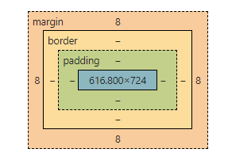

Slide 9
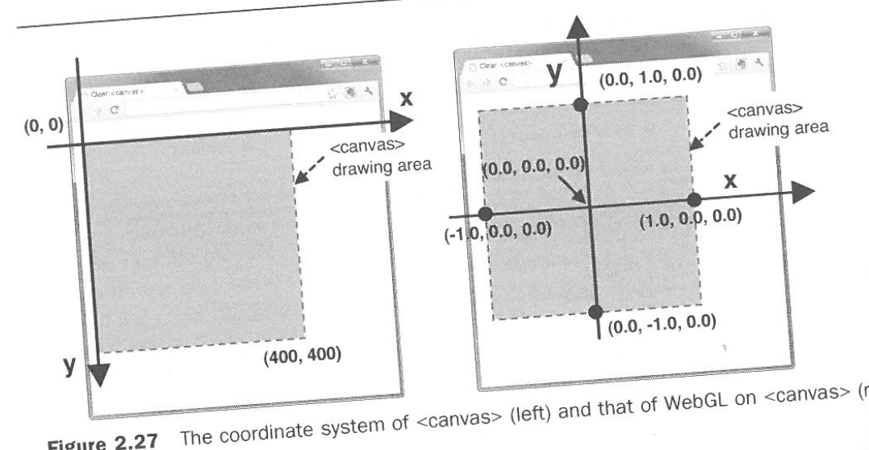

Slide 10
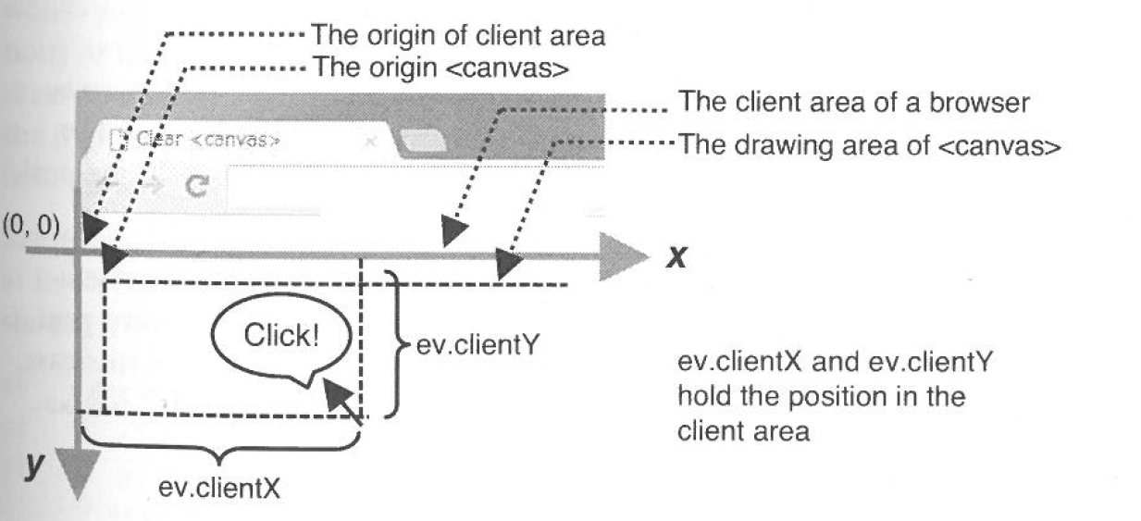

Slide 11
y – rect_top
canvas.height/2
x – rect.left
canvas.width/2

Slide 12
// MultiPoint.js (c) 2012 Matsuda
function main() {
// Write the positions of vertices to a vertex shader
initVertexBuffers(gl); // Draw three points
gl.drawArrays(gl.POINTS, 0, 3);
}
function initVertexBuffers(gl) {
var vertices = new Float32Array([0.0, 0.5, -0.5, -0.5, 0.5, -0.5]);
// Bind the buffer object to target
gl.bindBuffer(gl.ARRAY_BUFFER, vertexBuffer);
// Write date into the buffer object
gl.bufferData(gl.ARRAY_BUFFER, vertices, gl.STATIC_DRAW); var a_Position = gl.getAttribLocation(gl.program, 'a_Position');
// Assign the buffer object to a_Position variable
gl.vertexAttribPointer(a_Position, 2, gl.FLOAT, false, 0, 0); // Enable the assignment to a_Position variable
gl.enableVertexAttribArray(a_Position);
}

Slide 13
// correctedHelloQuad_FAN.js (c) 2012 Matsuda, modified by Nelson Max
function main() {
initVertexBuffers(gl);
...
gl.drawArrays(gl.TRIANGLE_FAN, 0, 4);
}
function initVertexBuffers(gl) {
var vertices = new Float32Array([-0.5, 0.5, -0.5, -0.5, 0.5, -0.5, 0.5, 0.5]); // Create a buffer object
var vertexBuffer = gl.createBuffer(); // Bind the buffer object to target
gl.bindBuffer(gl.ARRAY_BUFFER, vertexBuffer);
// Write date into the buffer object
gl.bufferData(gl.ARRAY_BUFFER, vertices, gl.STATIC_DRAW); var a_Position = gl.getAttribLocation(gl.program, 'a_Position');
// Assign the buffer object to a_Position variable
gl.vertexAttribPointer(a_Position, 2, gl.FLOAT, false, 0, 0); // Enable the assignment to a_Position variable
gl.enableVertexAttribArray(a_Position);
}

Slide 14
// HelloQuad_LINE_LOOP.js (c) 2012 Matsuda, modified by Nelson Max
function main() {
initVertexBuffers(gl);
...
gl.drawArrays(gl.LINE_LOOP, 0, 3);
}
function initVertexBuffers(gl) {
var vertices = new Float32Array([-0.5, 0.5, -0.5, -0.5, 0.5, 0.5, 0.5, -0.5]); // Create a buffer object
var vertexBuffer = gl.createBuffer(); // Bind the buffer object to target
gl.bindBuffer(gl.ARRAY_BUFFER, vertexBuffer);
// Write date into the buffer object
gl.bufferData(gl.ARRAY_BUFFER, vertices, gl.STATIC_DRAW); var a_Position = gl.getAttribLocation(gl.program, 'a_Position');
// Assign the buffer object to a_Position variable
gl.vertexAttribPointer(a_Position, 2, gl.FLOAT, false, 0, 0); // Enable the assignment to a_Position variable
gl.enableVertexAttribArray(a_Position);
}

Slide 15
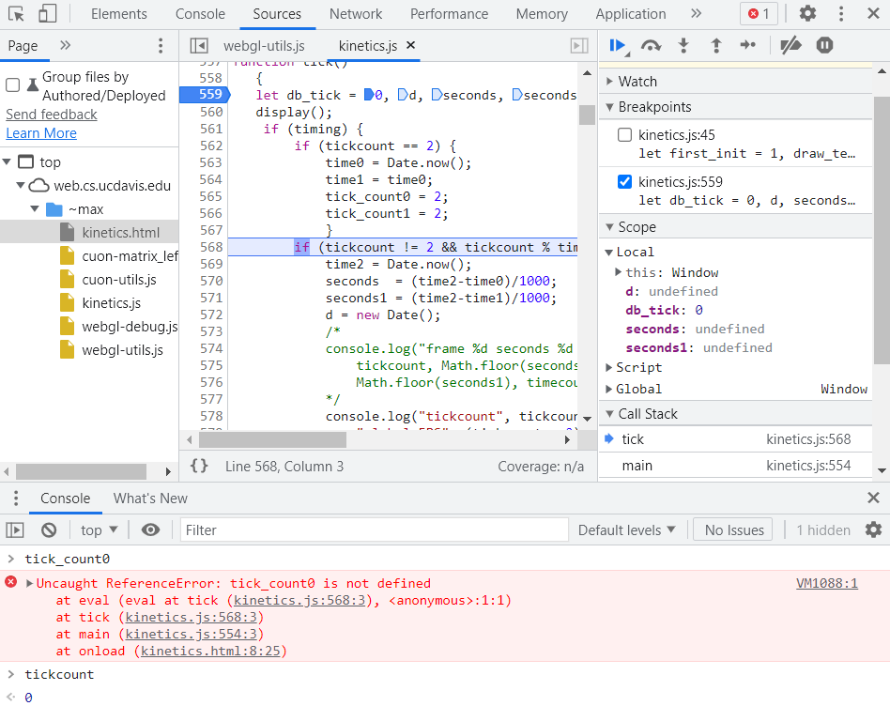

Slide 17
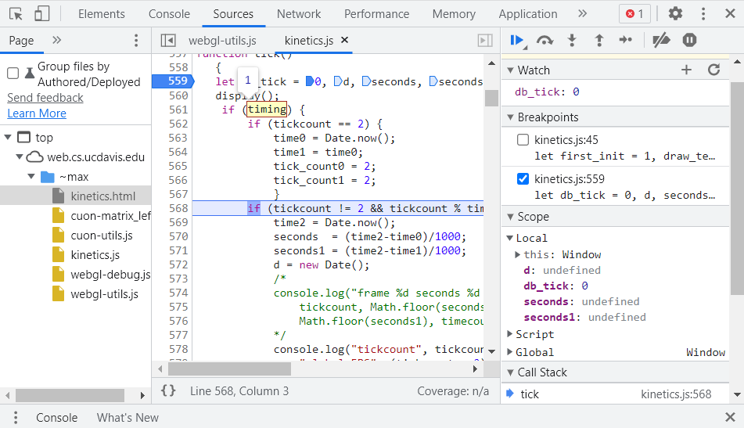

Slide 18
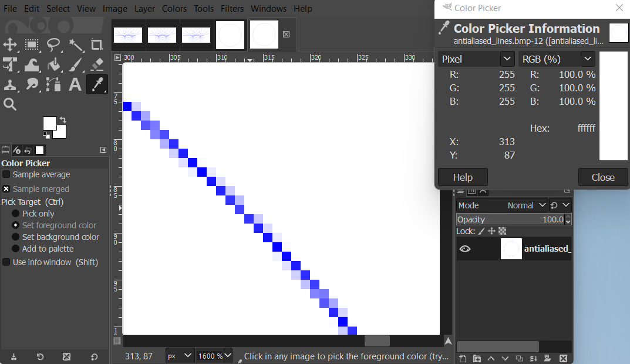

Slide 19
Class Exercise: Draw a triangle-fan polygon with an outline using mouse clicks
Combine the three WebGL / JavaScript examples files ClickedPoints.js from ch02, and HelloQuadFan.js and HelloQuad_LINE_LOOP.js from ch03 to draw a polygon with a fill color, together with its outline in another color, over a background in a third color. Create a fixed size new Float32Array(100) with room for 50 vertex pairs from clicked points, and pass is as the vertex attribute buffer.

